Slide 1
Lab 5:
Max Heap
CS010C

Slide 2
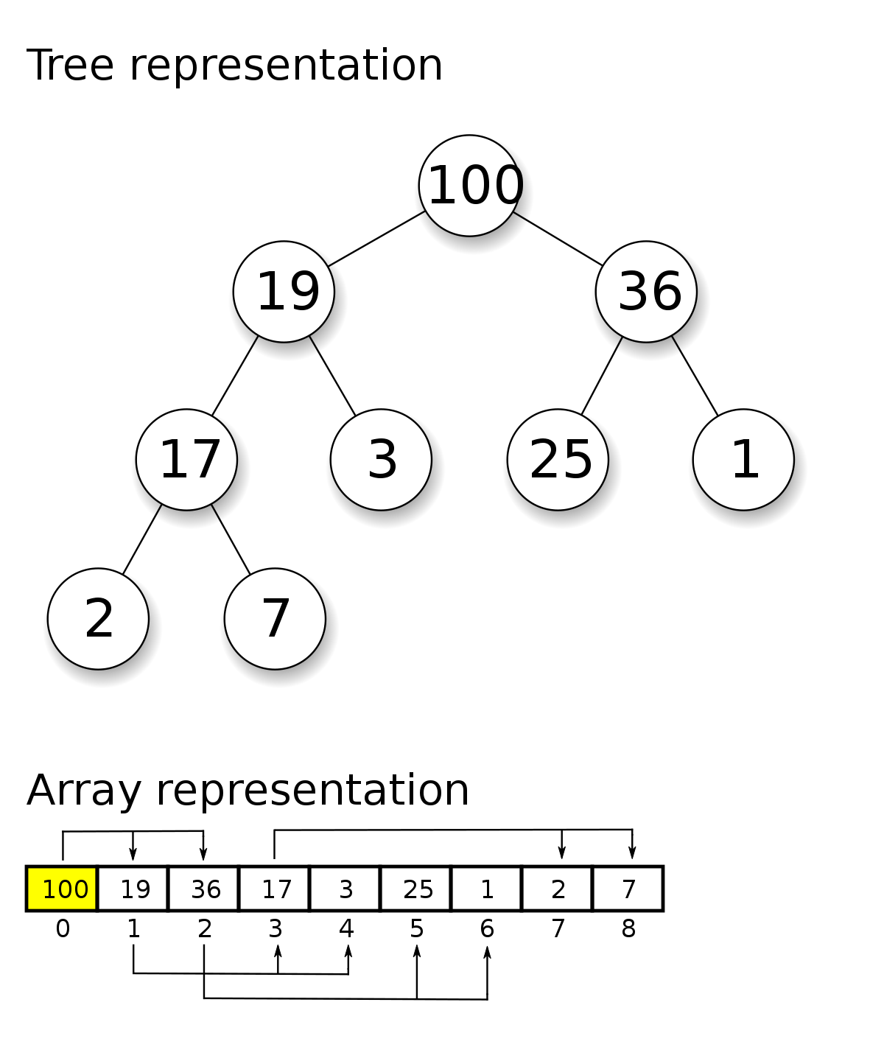
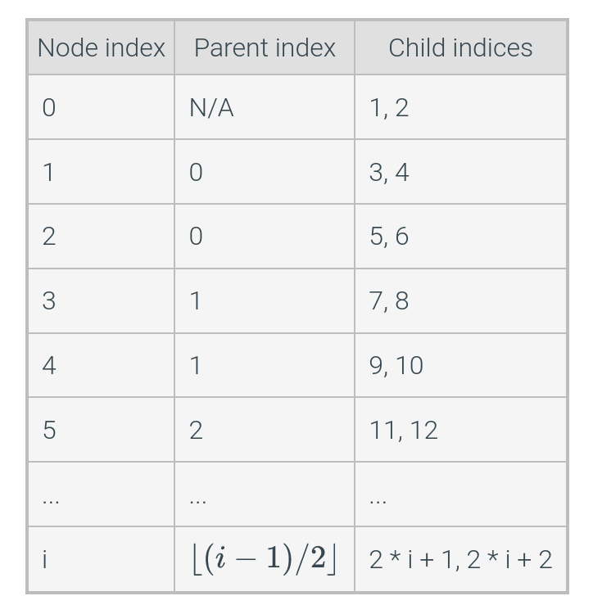
Lab 5: Heaps
Heap property - children lesser or greater than parent
Max
Min
Children not ordered, just has to satisfy property
Two implementations
Array
Complete binary tree
Tree and array representation of a heap and how to convert from parent to child index

Slide 3
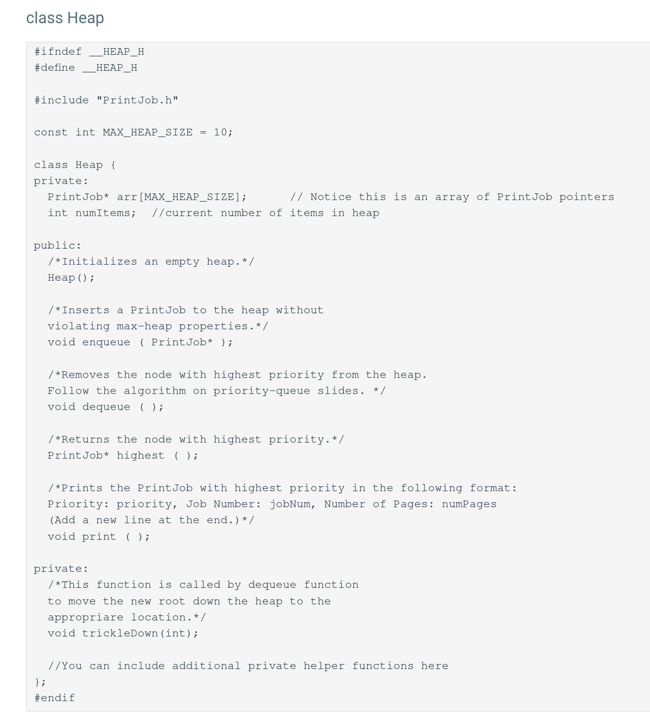
Lab 5: Heap Class
Array representation
Stores Print Jobs
Public methods
Enqueue
Dequeue
Private methods
Percolate up
Percolate down

Slide 4
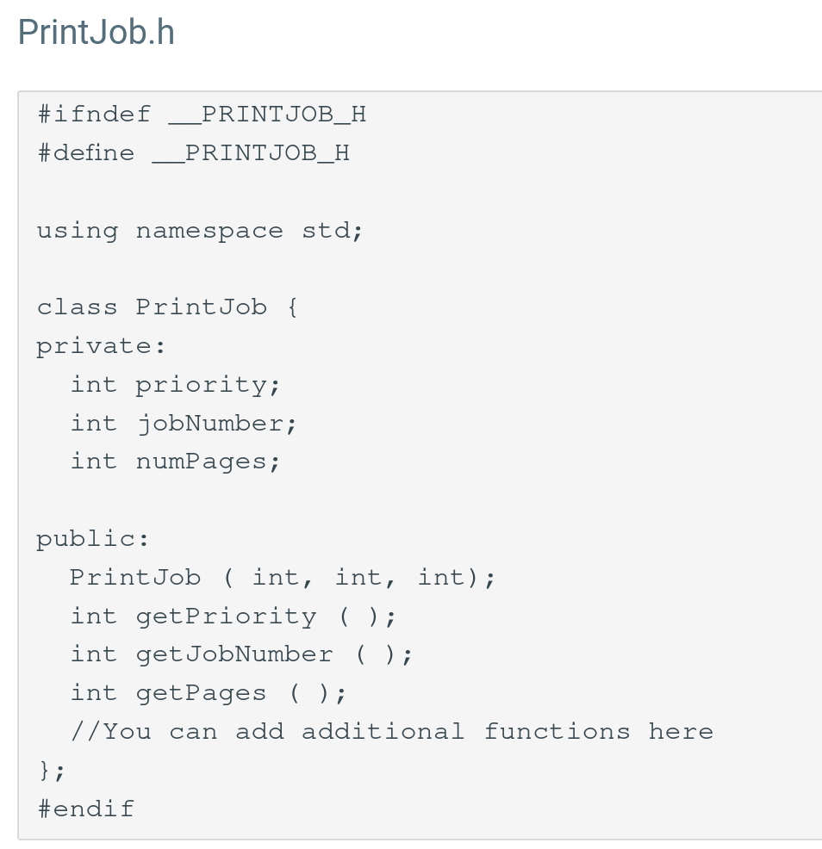
Lab 5: Print Job
Object to store in the heap
Higher priority, higher position in the heap

Slide 5
Lab 5: Heap Insert
Insert at the last element
Percolate up
Repeat until the heap property isn’t violated

Slide 6
Lab 5: Heap Remove
Remove the root
Replace the root with the last node
Swap the node with its highest priority child if it exists
Repeat while a higher priority child exists

Slide 7
Thank you!
Questions?

